Slide 1
Animal Assistance AV System
Choose a Category below to navigate to its walkthrough
Wireless Presentation
HDMI & USB Cables
Powering Off System

Slide 2
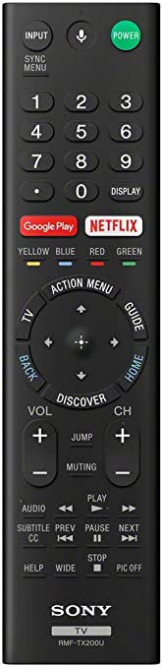
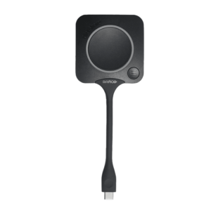
Wireless Presentation
2
1
1. Use the TV Remote to Turn on the TV
2. Press the HDMI button and select HDMI 1
3. Plug the Clickshare Puck into your laptop
4. Wait until the White pulsing light on the Clickshare puck stops flashing
5. Press the Button on the puck to start sharing
Use Clickshare For
Video
Conferencing

Slide 3
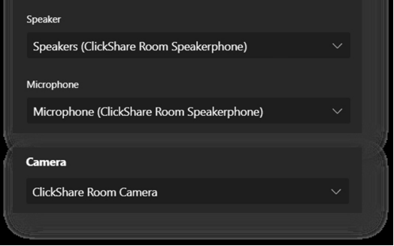
Wireless Video Conferencing
1. Open your Video Conferencing platform(zoom, Teams, Go To)
2. Find your Driver Settings (Camera, Mic, Speaker Output)
3. Select ROOM CAMERA as your camera
4. Select CLICKSHARE ROOM SPEAKERPHONE as your mic
5. Select CLICKSHARE ROOM SPEAKERPHONE as your audio output
Main
Menu
Clickshare for Local Presentation

Slide 4
HDMI & USB Cables
1. Use the TV Remote to Turn on the TV
2. Press the HDMI button and select HDMI 2
1
2
3. Plug the USB and HDMI cables into your laptop
4. Use this for Local presentation or Video Conferencing
5. For Video Conferencing, select BOSE SOUND BAR/VB1 as your Camera, audio, Mic settings
Main
Menu

Slide 5
Powering Off System
1. Use the TV Remote to Turn off the TV
2. Unplug all cables and pucks
1
Main
Menu

